Slide 1
Trailblazor: Building Dynamic Applications with Blazor
.NET Conf 2020
Shaun Walker
Nov 12, 2020
16:00 ET | 13:00 PT

Slide 2
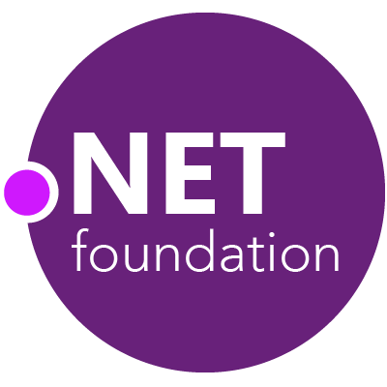
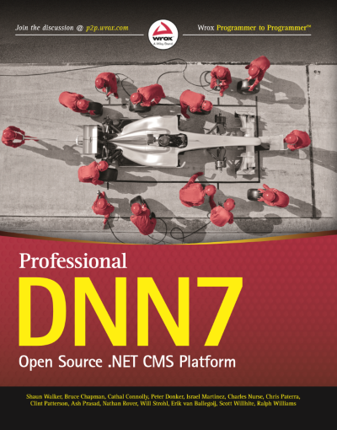
Shaun Walker
Creator of DotNetNuke
Microsoft MVP
ASP Insider
Creator of Oqtane
Chair of .NET Foundation Project Committee
Technical Director & Enterprise Guildmaster

Slide 3
Dynamic Applications…
Plug-in Applications…
Modular Applications…
Dynamic Applications…

Slide 4
Dynamic Application Benefits
Extensibility: applications are loosely coupled and can be dynamically extended to include new features
Parallel Development: features can be developed in parallel by different teams without stepping on each others toes
Conventions: development adheres to well defined contracts which produce consistent and predictable outcomes
Encapsulation: features are developed in a self-contained manner with a singular responsibility and focus
Deployment: features can be deployed independently using modern deployment approaches

Slide 5
Dynamic Applications
are difficult to create…
so developers usually rely on
Web Application Frameworks

Slide 6
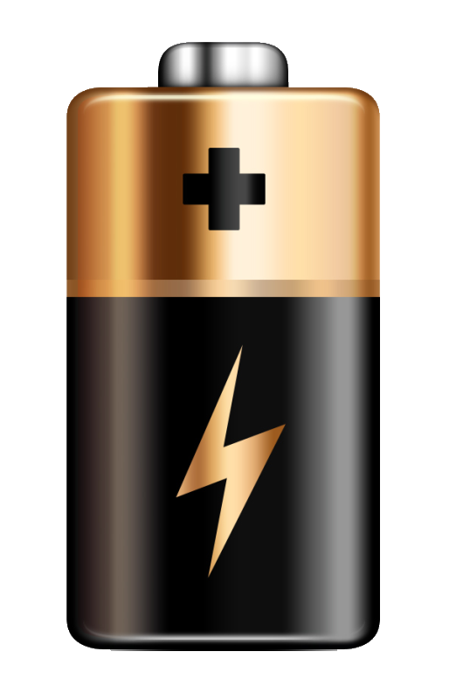
All of the basic components that a developer needs to immediately get up and running

Slide 7
Popular “Batteries Included” Frameworks

Slide 8
Content Management Systems?
C M S ?

Slide 9
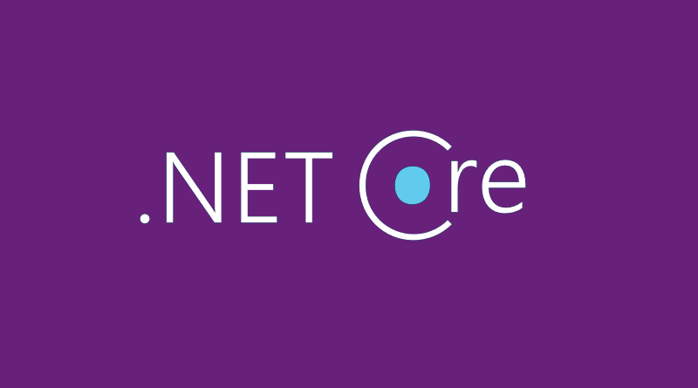
Frameworks are one of the primary drivers of platform adoption

Slide 10
Popular .NET Web Frameworks

Slide 11
Blazor is a single-page application framework for building interactive web apps with .NET Core.

Slide 12
A Modular Application Framework for Blazor

Slide 13
Oqtane Framework
“Batteries Included” framework for .NET Core / Blazor
Rapidly create modern web applications using less code
Robust set of application building blocks and services
Open source ( MIT License / .NET Foundation )
Supports both Blazor Server and Blazor WebAssembly
“Rocket Fuel for Blazor”

Slide 14
Oqtane Framework
Multi-Tenant
Portal UI Framework
Granular Permissions
Admin User Interface
Dynamic Routing
Modular Architecture
Customizable Themes
Headless API & Repository

Slide 15
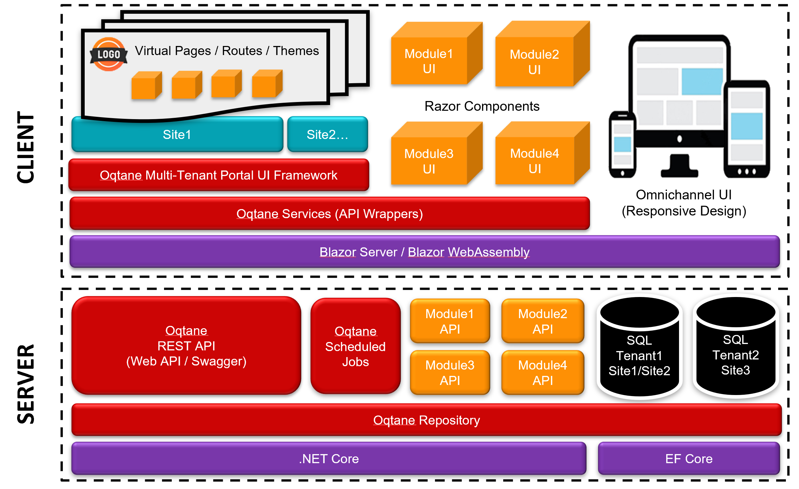
Oqtane Architecture

Slide 16
Demo

Slide 17
Dynamic Application Considerations
Assembly Loading (Server/Client)
Application Startup
Service Registration / Dependency Injection
Routing
Razor Component Rendering
Blazor Hosting Models
Deployment

Slide 18
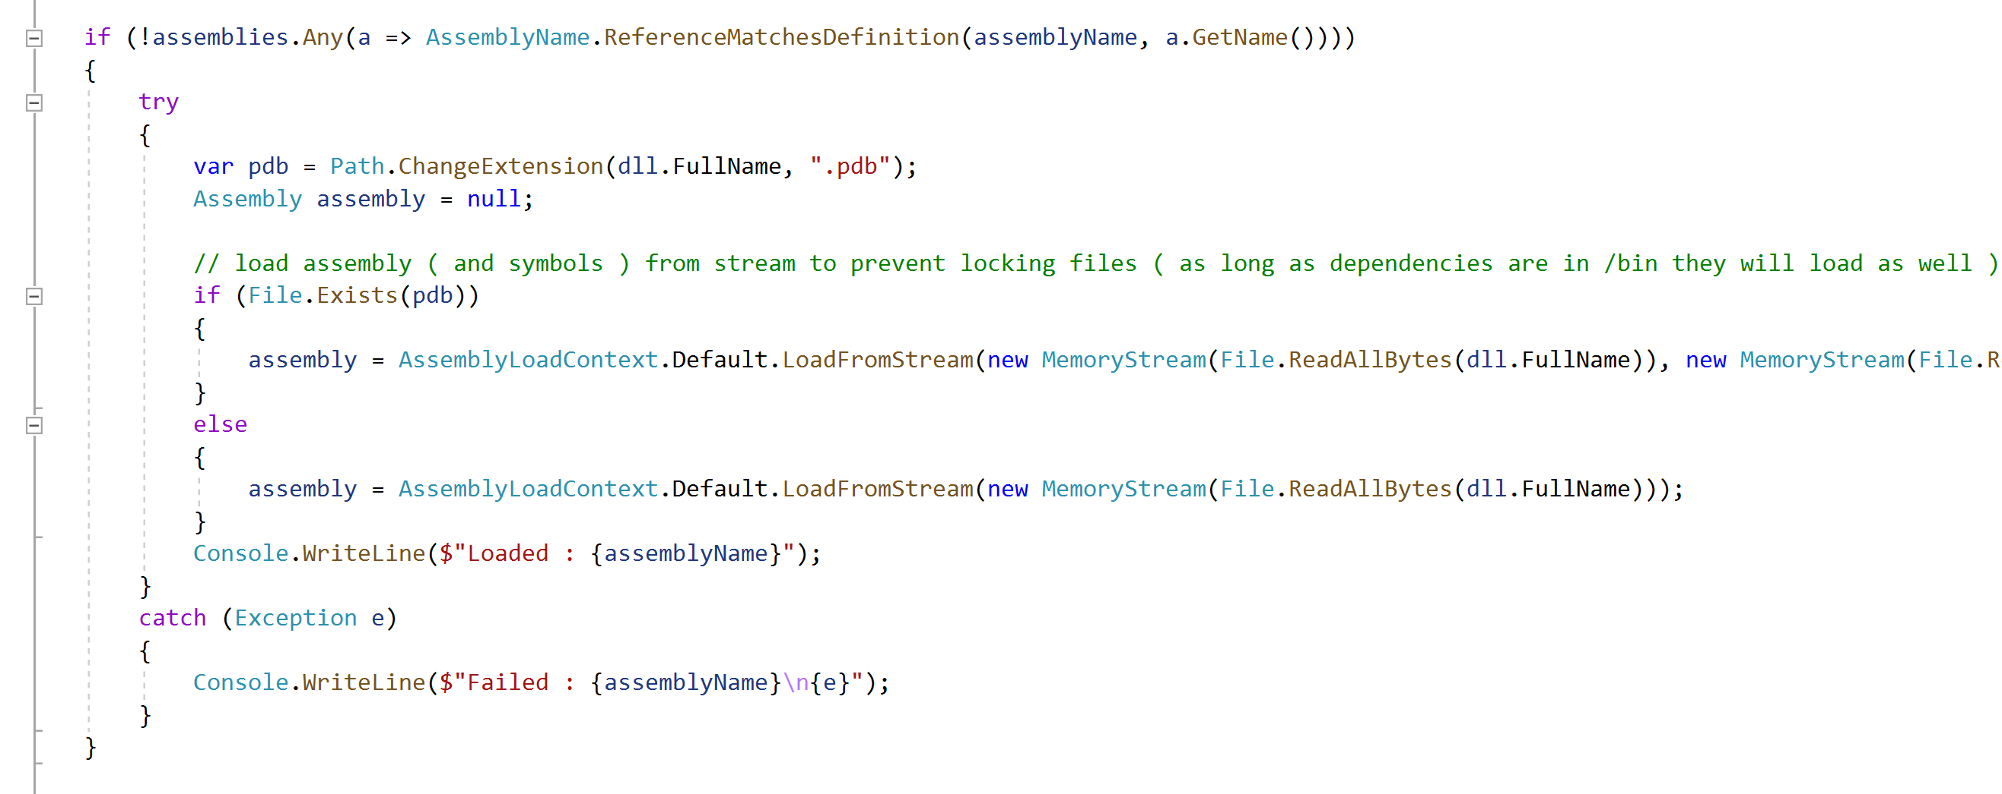
Assembly Loading (Server)
.NET Core does not automatically load assemblies unless they are statically linked ( ie. tightly coupled ) to your main application
A dynamic application needs to dynamically load its loosely coupled assemblies
.NET Core provides methods for loading assemblies into the default AppDomain ( ie. AssemblyLoadContext )
Oqtane uses conventions to identify assemblies in the /bin and load them during startup

Slide 19
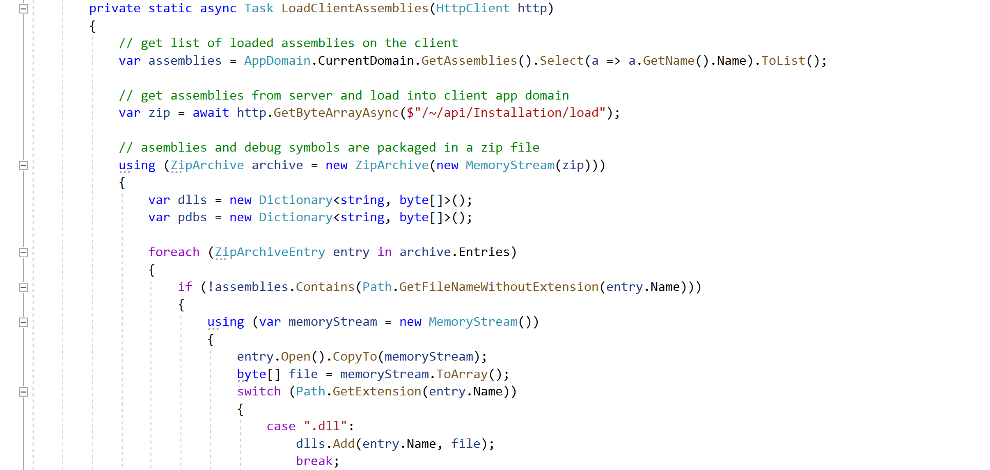
Assembly Loading (Client)
When running on Blazor WebAssembly, assemblies need to be downloaded from the server to the client browser
By default, Blazor only downloads assemblies which are statically linked to your main Blazor application
A dynamic application needs to download its loosely coupled assemblies and load them into the client AppDomain
Blazor provides methods for downloading assemblies ( ie. http.GetByteArrayAsync() )
Oqtane packages any loosely coupled assemblies into a ZIP file and downloads them to the client where they are loaded into the AppDomain

Slide 20
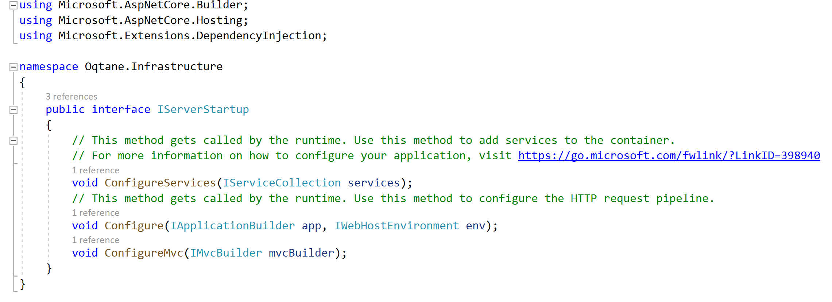
Application Startup
.NET Core requires that configuration be defined in a Startup class in your main application
A dynamic application must provide the ability for third parties to dynamically provide additional configuration information during startup
Oqtane defines an interface which emulates the .NET Core startup characteristics ( ie. ConfigureServices(), Configure() ).
Third parties can implement this interface and the logic will be executed during startup.

Slide 21
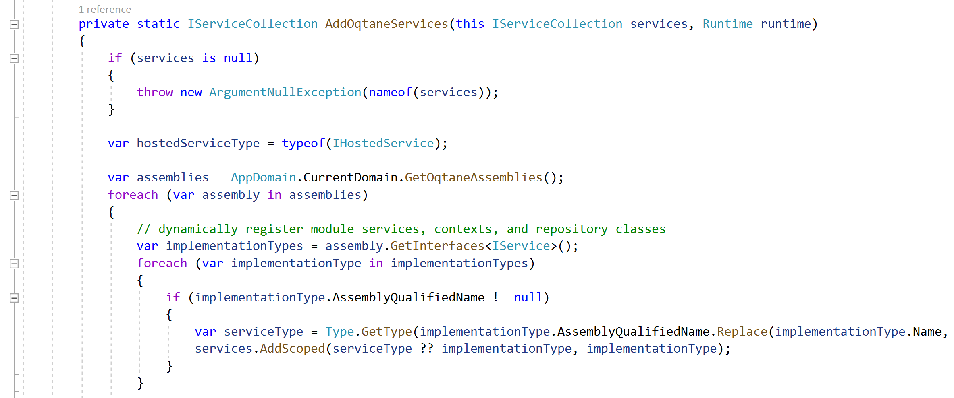
Service Registration
In order to support dependency injection, .NET Core requires that dependencies be registered in a Startup class in your main application
A dynamic application must provide the ability for third parties to dynamically register their own dependencies during startup
Oqtane defines a generic interface named IService which developers can use to decorate their service classes
The framework discovers these service classes during startup and automatically registers them in the service container

Slide 22
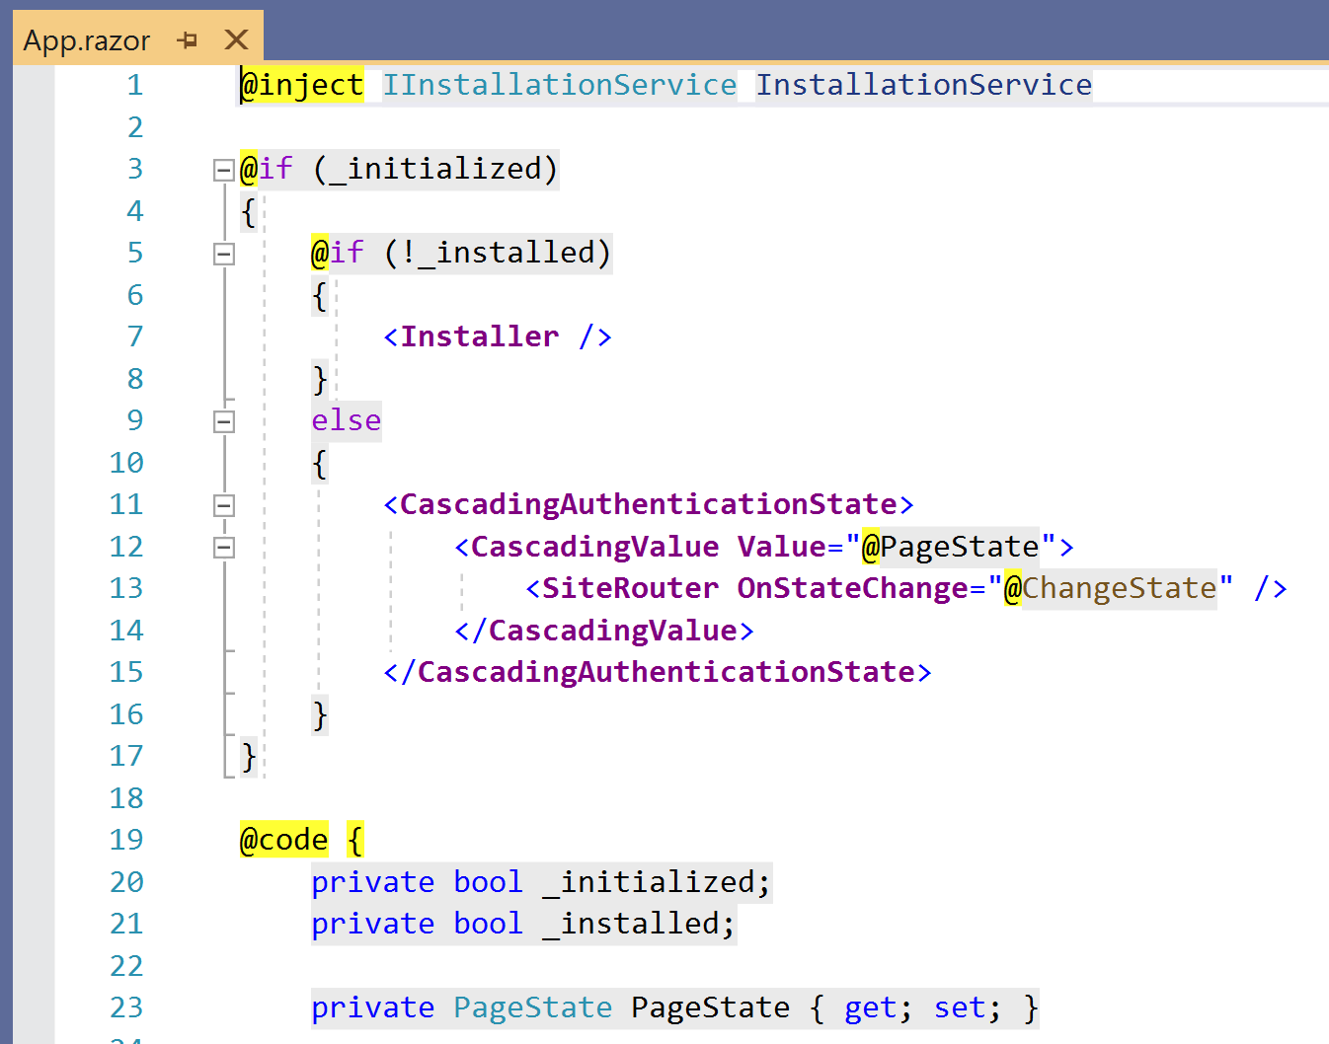
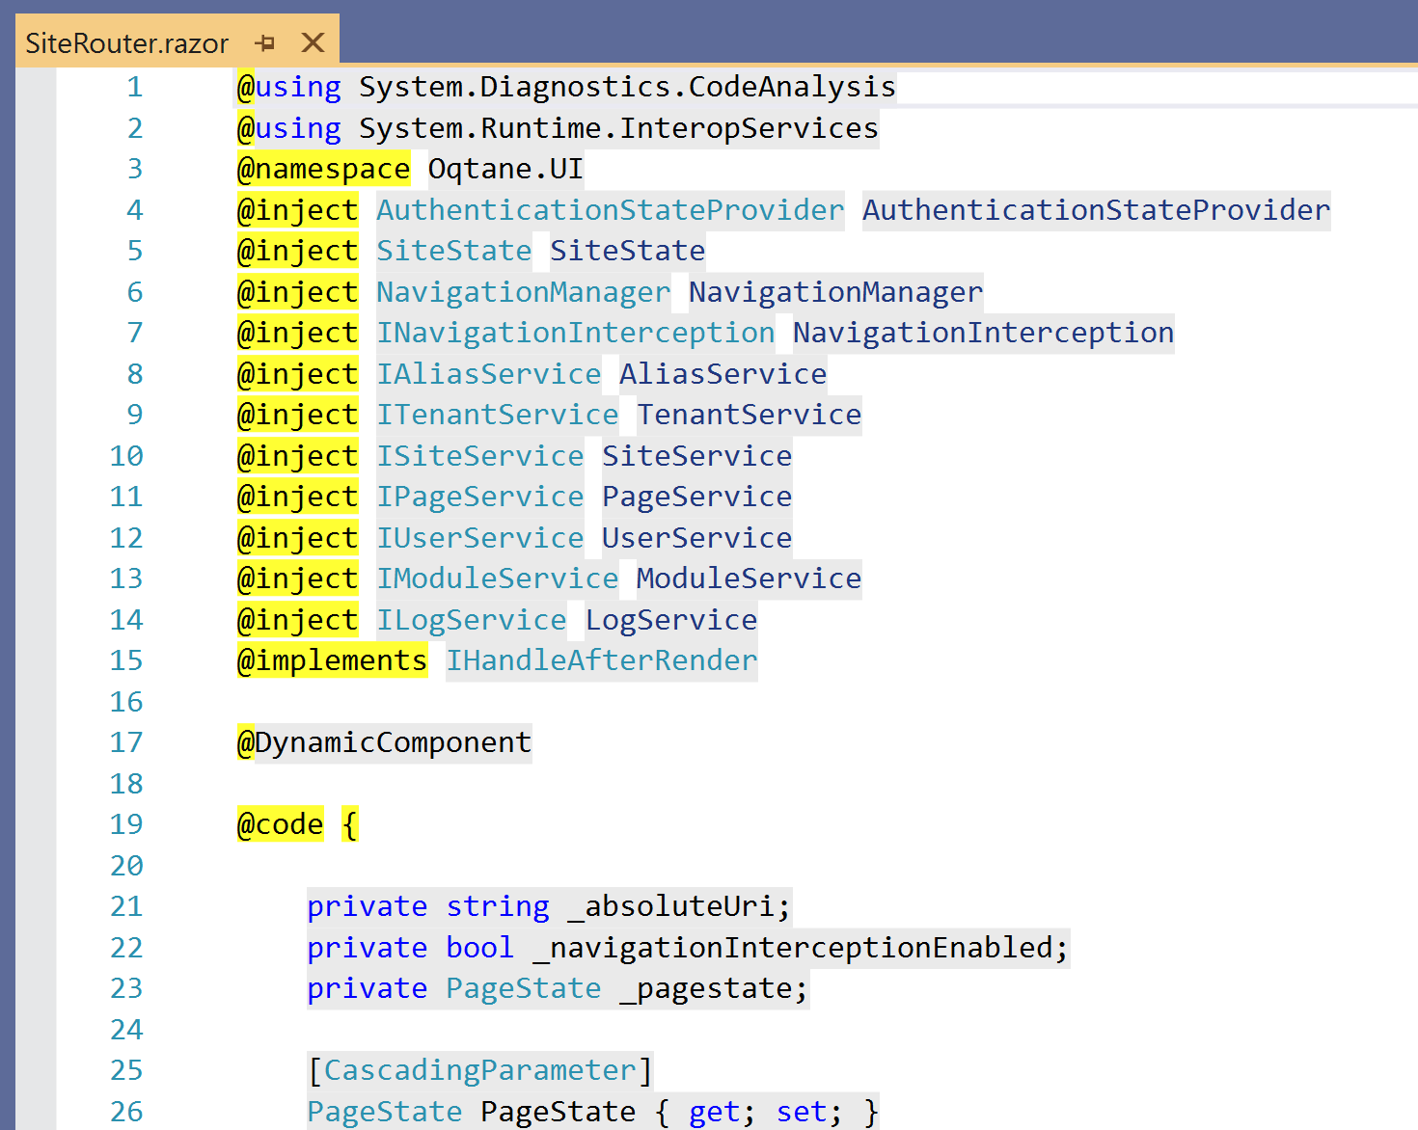
Routing
Blazor provides a default router which requires developers to specify page directives (@page) directly in their razor components.
A dynamic application requires specific route conventions to be followed so that modules will function correctly within its environment
Blazor allows you to easily replace the default router with a custom router (a router is simply a razor component)
Oqtane replaces the default router with a custom version which supports multi-tenancy, state management, authentication, and url conventions specific to the environment.

Slide 23
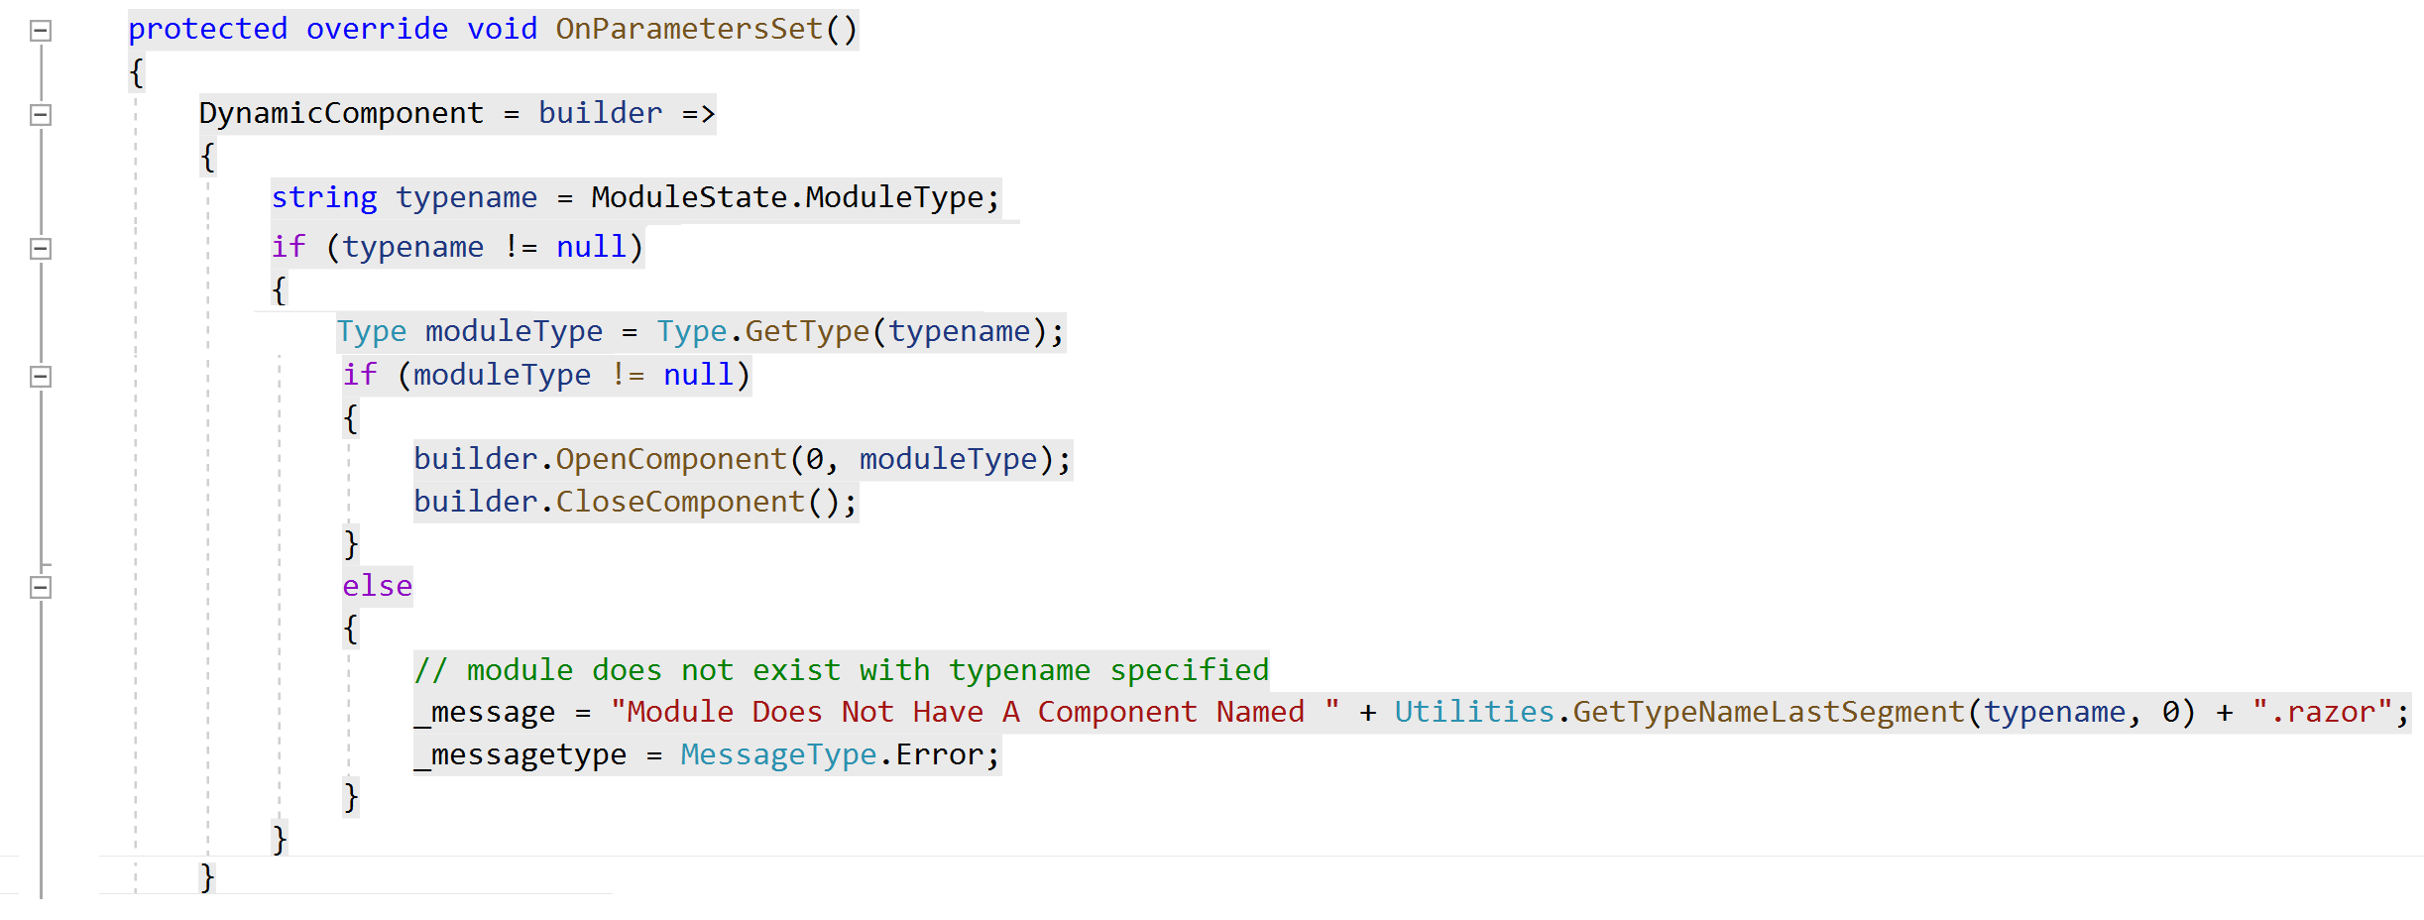
Razor Component Rendering
The razor component model is very powerful and allows developers to create reusable components
By default component references are typically embedded directly in your UI markup ( ie. <mycomponent> )
A dynamic application need to be able to dynamically render components based on configuration that is stored outside of the application
Blazor has primitives which can be used for dynamic rendering.
Oqtane utilizes these primitives to dynamically render themes and modules.

Slide 24
Blazor Hosting Models
Blazor currently officially supports two hosting models: Blazor Server and Blazor WebAssembly
A dynamic application needs to allow developers to utilize the hosting model which is most applicable to their use case
It is possible to create applications which can function in both hosting models, as long as they pay attention to where the workloads are executing
Oqtane allows developers to switch between hosting models by simply modifying a single setting in appsettings.json

Slide 25
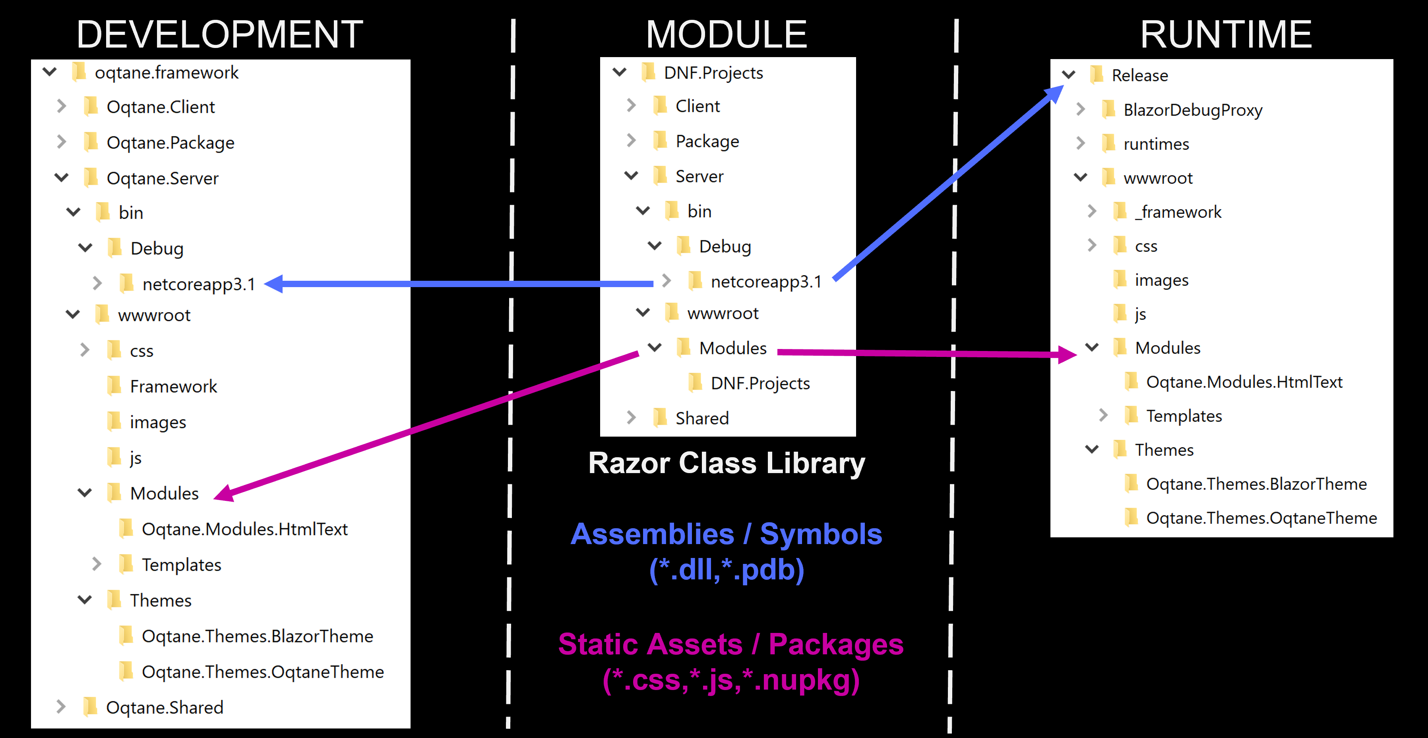
Deployment
.NET Core supports some streamlined deployment options through Visual Studio, however these deployment options rely on application dependencies to be statically linked to the main application
A dynamic application is loosely coupled and has additional assemblies and static resources which need to be deployed to the runtime environment
Oqtane allows developers to package their modules and themes as standard Nuget packages which can be uploaded and installed at runtime into the environment

Slide 26
Oqtane 2.0
Migrated to .NET 5
Localization Support
and much more…
https://www.oqtane.org https://github.com/oqtane/oqtane.framework

Slide 27
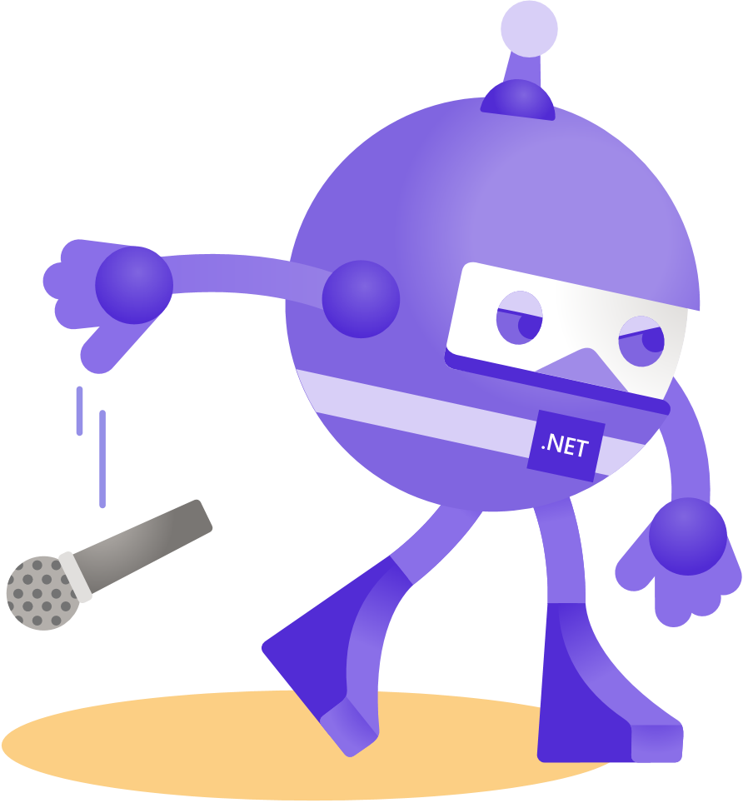
Thanks for joining!

